Slide 1

Module 1: Mean Value Theorems
Department of Mathematics Jain Global campus, Jakkasandra Post, Kanakapura Taluk, Ramanagara District -562112
Prof. Veeresh Malagi
Department of Mathematics,
FET, Jain(Deemed-to-be-University)

Slide 2
CONTENTS
Mean Value Theorems
Lagrange's Mean Value theorem
Geometrical Interpretation
Problems

Slide 3
Lagrange’s Mean Value Theorem

Slide 4
Lagrange’s Mean value Theorem

Slide 5
Proof:

Slide 6
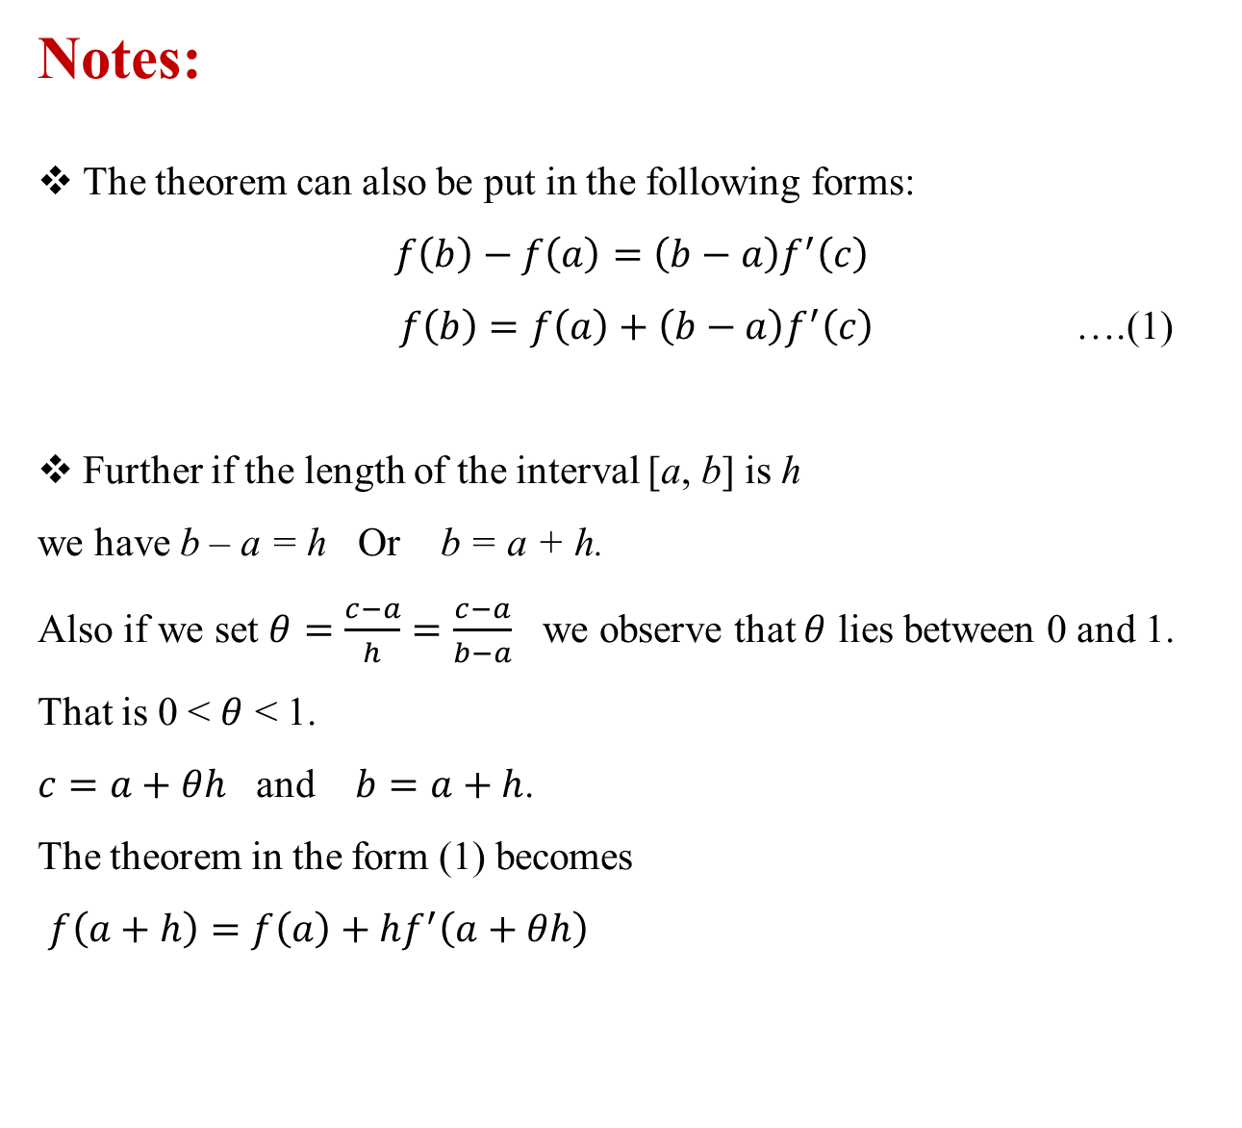
Notes:
The theorem can also be put in the following forms:
$$f\left(b\right)−f\left(a\right)=\left(b−a\right)f^{′}\left(c\right)$$
$f\left(b\right)=f\left(a\right)+\left(b−a\right)f^{′}\left(c\right)$ ….(1)
Further if the length of the interval [a, b] is h
we have b – a = h Or b = a + h.
Also if we set $θ=\frac{c−a}{h}=\frac{c−a}{b−a}$ we observe that $θ$ lies between 0 and 1. That is 0 <$θ$< 1.
$c=a+θh$ and $b=a+h$.
The theorem in the form (1) becomes
$f\left(a+h\right)=f\left(a\right)+hf^{′}\left(a+θh\right)$

Slide 7
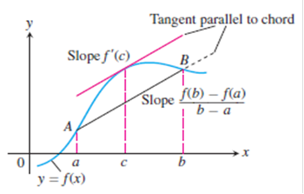
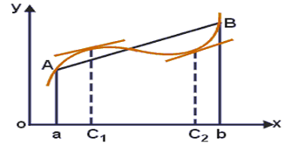
Geometrical Interpretation
There are no breaks or gaps in between a and b for the given curve and including at the end points, hence the given function is continuous in [a, b] .
Since a unique tangent can be drawn at each and every point in the interval except at the end points, the function is differentiable in the (a, b) .
Conclusion: Therefore there exits at least one point ‘c’ (say) in between a and b at which the tangent at ‘c’ is parallel to the chord AB.

Slide 8

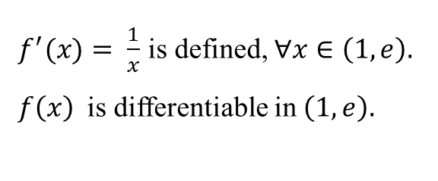


Problems on Lagrange's Mean Value theorem:
1. Verify Lagrange’s Mean Value Theorem for the function in [1, e]
Solution:
$f\left(x\right)$is continuous in [1, e].
$f^{′}(x)= \frac{1}{x}$is defined, $∀x∈\left(1,e\right).$
$f\left(x\right)$ is differentiable in $\left(1,e\right).$
$$⇒$$
$$⇒$$
All conditions of Lagrange’s Mean Value Theorem are satisfied,
therefore there exist one point ‘c’ such that
Hence Lagrange’s Mean Value Theorem is verified.

Slide 9


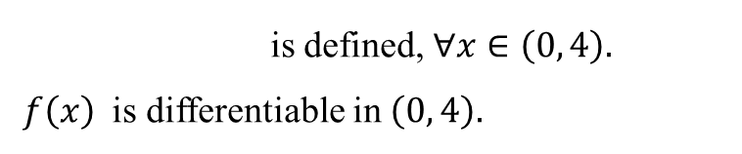
2. Verify Lagrange’s Mean Value Theorem for the function in [0, 4]
Solution:
f(x) is continuous function as it is an algebraic function in [0, 4]
is defined, $∀x∈\left(0, 4\right).$
$f\left(x\right)$ is differentiable in $\left(0, 4\right).$
$$⇒$$
All conditions of Lagrange’s Mean Value Theorem are satisfied,
therefore there exist one point ‘c’ such that
and 0.85 both $∈\left(0, 4\right).$

Slide 10
Verify Lagrange’s Mean Value Theorem for the function $f\left(x\right)=x(x−1)(x−2)$
in [0, 1/2]
Solution:
$f\left(x\right)$is continuous in [1, e].
$f^{′}(x)= \frac{1}{x}$is defined, $∀x∈\left(1,e\right).$
$f\left(x\right)$ is differentiable in $\left(1,e\right).$
$$⇒$$
$$⇒$$
All conditions of Lagrange’s Mean Value Theorem are satisfied,
therefore there exist one point ‘c’ such that
Hence Lagrange’s Mean Value Theorem is verified.

Slide 11

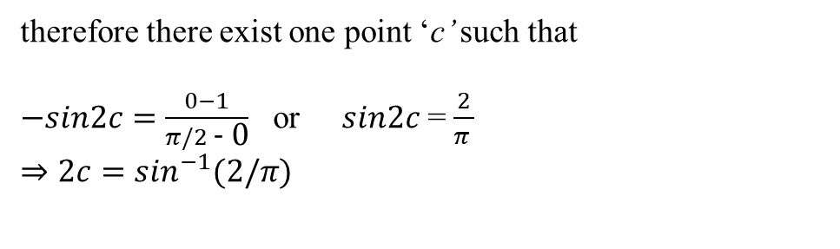


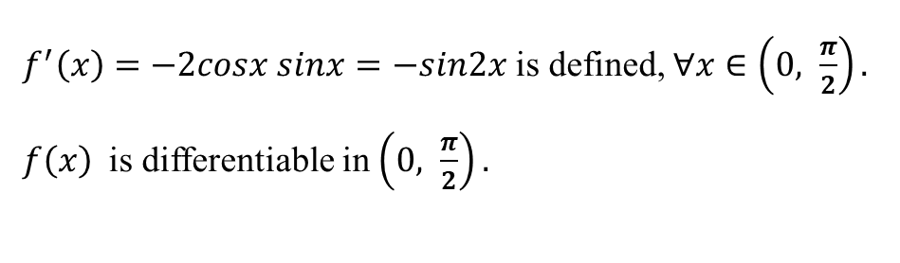
4. Verify Lagrange’s Mean Value Theorem for the function $f\left(x\right)=$$\cos^{2}x$ in [0, $\frac{π}{2}$]
Solution:
$f\left(x\right)$is continuous in [$0, \frac{π}{2}$].
$f^{′}\left(x\right)=−2cosx sinx=−sin2x$ is defined, $∀x∈\left(0, \frac{π}{2}\right).$
$f\left(x\right)$ is differentiable in $\left(0, \frac{π}{2}\right).$
$$⇒$$
$$⇒$$
All conditions of Lagrange’s Mean Value Theorem are satisfied,
therefore there exist one point ‘c’ such that
$−sin2c=\frac{0−1}{π/2\text{ − }\text{0}}$ or $sin2c$ = $\frac{2}{π }$
$⇒$$2c=\sin^{−1}(2/π)$
Therefore c = 0.345 $∈ [0,π/2]$
Hence Lagrange’s Mean Value Theorem is verified.

Slide 12

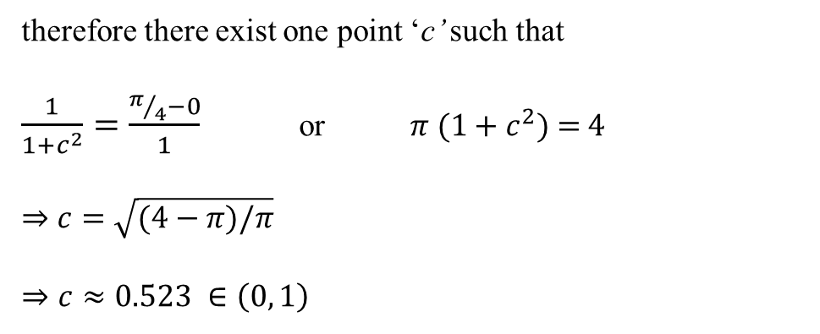


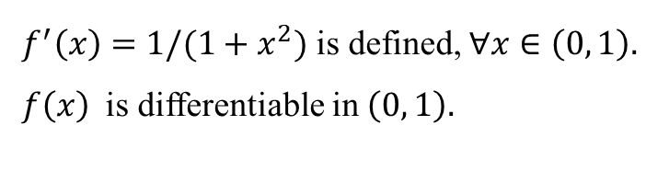
5. Verify Lagrange’s Mean Value Theorem for the function $f\left(x\right)=$$\tan^{−1}x$ in [0, 1]
Solution:
$f\left(x\right)$is continuous in [$0, 1$].
$$⇒$$
$f^{′}\left(x\right)=1/(1+x^{2})$ is defined, $∀x∈\left(0, 1\right).$
$f\left(x\right)$ is differentiable in $\left(0, 1\right).$
$$⇒$$
All conditions of Lagrange’s Mean Value Theorem are satisfied,
therefore there exist one point ‘c’ such that
$\frac{1}{1+c^{2}}=\frac{π/4−0}{1}$ or $π (1+c^{2})$ = 4
$⇒$$c=\sqrt{(4−π)/π}$
$⇒c≈0.523 ∈\left(0, 1\right)$
Hence Lagrange’s Mean Value Theorem is verified.

Slide 13

6.
Solution:
Applying Lagrange's mean value theorem for this f(x) in [0, x], we have,
but
$$f^{′}\left(x\right)>0⇒f^{′}\left(c\right)>0$$
and hence
or

Slide 14
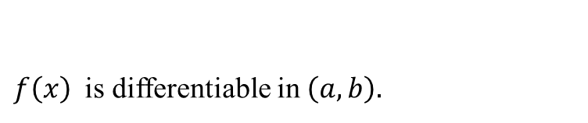
7. Prove that where using Lagrange’s
mean value theorem
Solution:
, f (x) is continuous in [a, b] and
$f\left(x\right)$ is differentiable in $\left(a, b\right).$
$$⇒$$
Applying Lagrange’s mean value theorem , for $f\left(x\right)$ in [ a, b]
We know that a < c < b
on multiplying by (b - a) which is positive, we have

Slide 15
8.

Slide 16
ii.

Slide 17
THANK YOU

